Slide 1
Unit II
Chapter 3: Boundary Value Testing

Slide 2
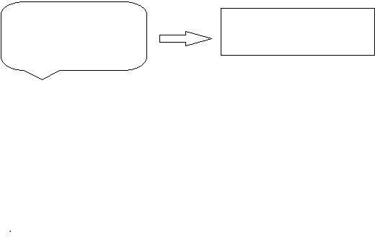
The practice of testing software has become one of the most important aspects of the process of software creation. When we are testing software the first and potentially most crucial step is to design test cases.
MANY TEST CASES
BEST TEST CASE

Slide 3
Boundary Value Testing
Boundary value analysis is a type of black box or specification based testing technique in which tests are performed using the boundary values.
Practically, due to time and budget considerations, it is not possible to perform exhausting testing for each set of test data, especially when there is a large pool of input combinations.
We use two techniques - Equivalence Partitioning & Boundary Value Analysis testing techniques to achieve this.

Slide 4

Definitions
“ Bugs lurk in corners and congregate at boundaries”
Boris Beizer
A boundary value:
an input value or output value which is on the edge of an equivalence partition or at the smallest incremental distance on either side of an edge, for example the minimum or maximum value of a range.
What is Boundary value analyze (BVA)?
Is a technique to refine equivalence partitioning based on testing at the boundaries between partitions
-
-

Slide 5
Goals of BVA Testing
Goals:
Find errors associated with the boundary values
Test levels:
•
•
•
•
Unit Integration System
System-integration
This technique is based on the risks:
•
•
A large number of problems occur at the boundaries of the input variables
Even if found equivalent classes correctly, boundary values may be incorrectly assigned to another class.

Slide 6
Introduction
Boundary testing is the process of testing between extreme ends or boundaries between partitions of the input values.
So these extreme ends like Start- End, Lower- Upper, Maximum-Minimum, Just Inside-Just Outside values are called boundary values and the testing is called "boundary testing".
The basic idea in boundary value testing is to select input variable values at their:
Minimum
Just above the minimum
A nominal value
Just below the maximum
Maximum

Slide 7
Boundary Value Analysis
In software Testing we can identify two major domains to test. Those are INPUTS & OUTPUTS.
Here for each of the domain how to use knowledge of the functional nature of a program to identify test cases for the program.
Input domain testing also called “boundary value testing” is the best-known specification-based testing technique.

Slide 8
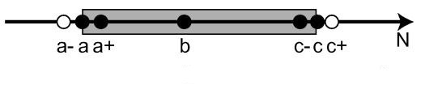
Steps for test cases
Test case design by BVA proceeds into 3 steps:
•
•
•
Determine the range of values (usually it is equivalence class) Determine boundary values
Check input variable value at the minimum, just above minimum, normal, just below maximum, at the maximum

Slide 9
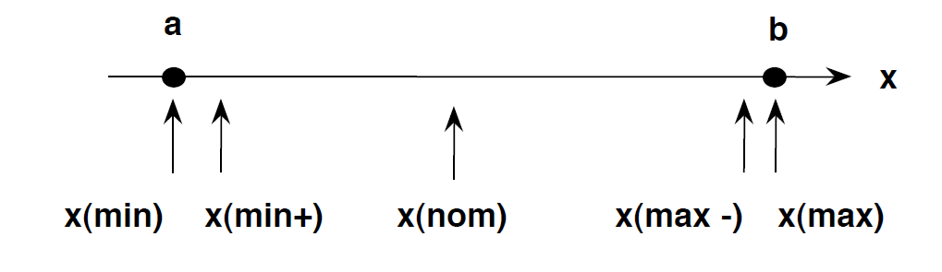
Cyclomatic Complexity
Cyclomatic Complexity=4n+1 yields test cases.

Slide 10
Example 1
An exam has a pass boundary at 50 percent, merit at 75 percent and distinction at 85 percent. The Valid Boundary values for this scenario will be as follows:
50,51 - for pass
75,76 - for merit
85,86 - for distinction
Boundary values are validated against both the valid boundaries and invalid boundaries.
The Invalid Boundary Cases for the above example can be given as follows:
0 - for lower limit boundary value
101 - for upper limit boundary value

Slide 11
Example 2
Example: Password field can not be shorter than 4 and longer than 28 (including) characters (numeric and alphabetic)
Equivalance classes
Boundary Values
0-3
4-28
28+1
{-1;0;1}, {2;3;4}
{3;4;5}, {27;28;29}

Slide 12
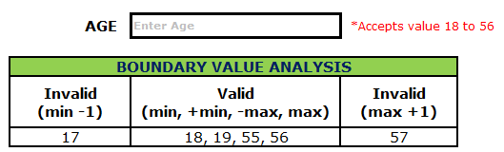
Example 4 on Boundary Value Analysis Test Case Design Technique:
Assume, we have to text a field which accepts Age 18 – 56

Slide 13
TEST CASES
Minimum boundary value is 18
Maximum boundary value is 56
Valid Inputs: 18,19,55,56
Invalid Inputs: 17 and 57
Test case 1: Enter the value 17 (18-1) = Invalid
Test case 2: Enter the value 18 = Valid
Test case 3: Enter the value 19 (18+1) = Valid
Test case 4: Enter the value 55 (56-1) = Valid
Test case 5: Enter the value 56 = Valid
Test case 6: Enter the value 57 (56+1) =Invalid

Slide 14
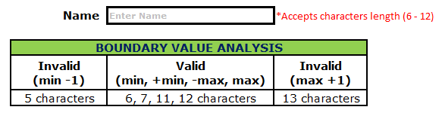
Example 2:
Assume we have to test a text field (Name) which accepts the length between 6-12 characters.

Slide 15
Test cases
Minimum boundary value is 6
Maximum boundary value is 12
Valid text length is 6, 7, 11, 12
Invalid text length is 5, 13
Test case 1: Text length of 5 (min-1) = Invalid
Test case 2: Text length of exactly 6 (min) = Valid
Test case 3: Text length of 7 (min+1) = Valid
Test case 4: Text length of 11 (max-1) = Valid
Test case 5: Text length of exactly 12 (max) = Valid
Test case 6: Text length of 13 (max+1) = Invalid

Slide 16
Robustness Testing
In BVA, we remain within the legitimate boundary of our range i.e. for testing we consider values like (min, min+, nom, max-, max) whereas in Robustness testing, we try to cross these legitimate boundaries as well.
Thus for testing here we consider the values like (min-, min, min+, nom, max-, max, max+)

Slide 17
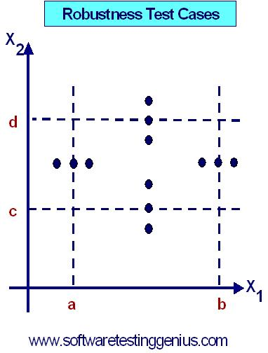

Slide 18
There are two independent considerations that apply to input domain testing.
1) Normal and Robust boundary value testing
2) Considering Single Fault Assumption
Normal Boundary Value Testing is concerned only with valid values of the input variables.
Robust boundary value testing = (Invalid Variable + Valid Variable ) values together.
The second consideration is we make the “single fault” assumption. This assumes that faults are due to incorrect values of any single variable.

Slide 19
Normal Boundary Value analysis
Input domain testing is the most commonly taught (and perhaps the most commonly used) software testing technique
We will see a number of approaches to boundary value analysis
We will then study some of the limitations of domain testing

Slide 20

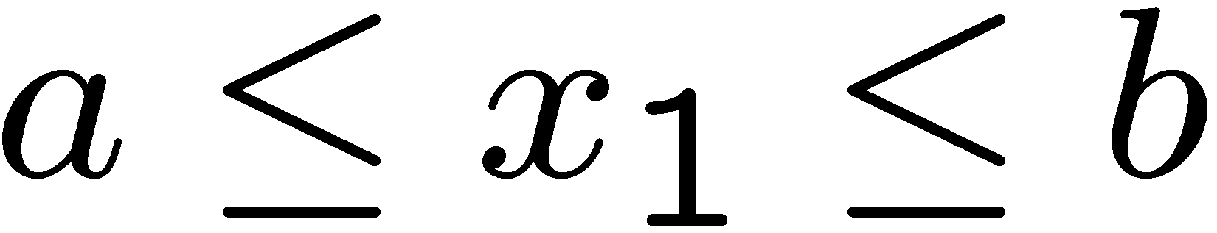
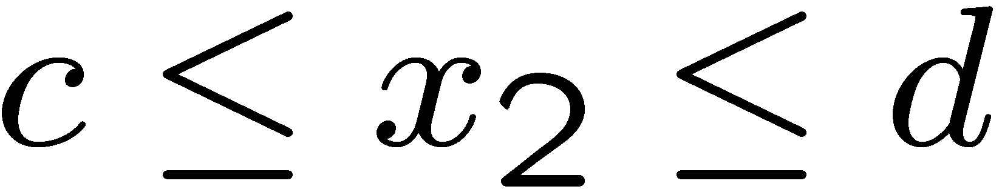
Boundary Value Analysis
Many programs can be viewed as a function F that maps values from a set A (its domain) to values in another set B (its range)
The input variables x1 and x2 of F will have some (possibly unstated) boundaries:

Slide 21
Lets define two variables x₁ and x₂. Where x₁ lies between a and b and x₂ lies between c and d.
a ≤ x1 ≤ b
c ≤ x2 ≤ d
The values of a, b, c and d are the extremities of the input domain. These are best demonstrated by the figure.

Slide 22
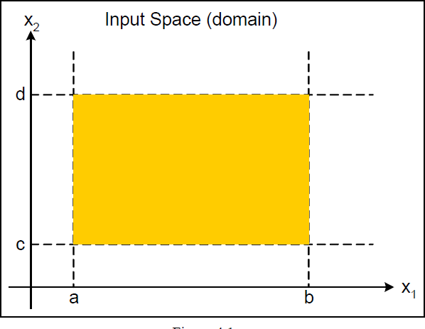
The yellow shaded area is the input domain.

Slide 23
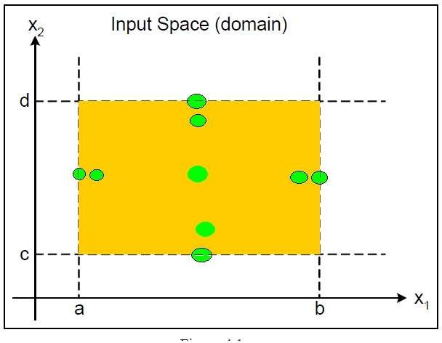
The green dots represent the boundary values.

Slide 24
The values used to test the extremities are:-
Min - Minimal
Min+ -----------------------Just above Minimal
Nom - Average
Max- ---------------------Just below Maximum
Max Maximum

Slide 25
Single fault assumption
Failures are only rarely the result of the simultaneous occurrence of two (or more) faults
Generate test cases as such for all i
Values of all but one variable x_{i} at nominal
x_{i} assumes all 5 values from previous slide

Slide 26
Two-variable function test cases
<x_{1nom}, x_{2min}>
<x_{1nom}, x_{2min+}>
<x_{1nom}, x_{2nom}>
<x_{1nom}, x_{2max-}>
<x_{1nom}, x_{2max}>
<x_{1min}, x_{2nom}>
<x_{1min+}, x_{2nom}>
<x_{1nom}, x_{2nom}>
<x_{1max-}, x_{2nom}>
<x_{1max}, x_{2nom}>

Slide 27
The NextDate Problem
The NextDate problem is a function of three variables: day, month and year. Upon the input of a certain date it returns the date of the day after that of the input.
The input variables have the obvious conditions:
1 ≤ Day ≤ 31. (Total number of test cases=4(3)+1=13)
1 ≤ month ≤ 12.
1812 ≤ Year ≤ 2012.

Slide 28
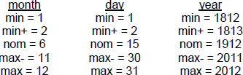

Slide 29
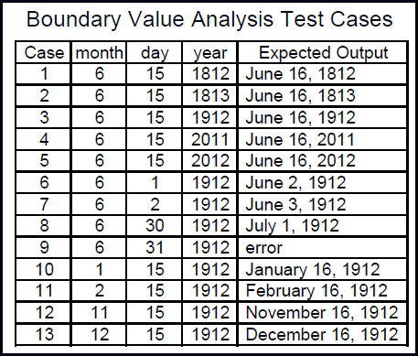

Slide 30
PROBLEM 2
For a Triangle Problem the 3 sides constitute 3 variables a, b, c. The result in Expected output we can observe in table below.
1 <=a >=10
1 <=b >=10
1 <=c >=10

Slide 31
TEST CASES | A | B | C | RESULT
1 | 5 | 5 | 1 | ISOCELES
2 | 5 | 5 | 5 | EQULATERAL
3 | 5 | 5 | 2 | ISOCELES
4 | 5 | 5 | 9 | ISOCELES
5 | 5 | 5 | 10 | NOT A TRAINGLE
6 | 5 | 1 | 5 | ISOCELES
7 | 5 | 2 | 5 | ISOCELES
8 | 5 | 9 | 5 | ISOCELES
9 | 5 | 10 | 5 | NOT A TRAINGLE
10 | 1 | 5 | 5 | ISOCELES
11 | 2 | 5 | 5 | ISOCELES
12 | 9 | 5 | 5 | ISOCELES
13 | 10 | 5 | 5 | NOT A TRAINGLE

Slide 32
Limitations
Does not work well for Boolean variables
Does not work well for logical variables
PIN, transaction type
Assumes independent variables
NextDate test cases unsatisfactory

Slide 33
Worst-Case Boundary Value testing
Both forms of boundary value testing, make the single fault assumption of reliability theory.
Rejecting single-fault assumption means that we are interested in what happens when more than one variable has an extreme value.
For each variable, we start with the five-element set that contains the min, min+, nom, max–, and max values.
worst-case testing for a function of n variables generates 5^{n} test cases, as opposed to 4n + 1 test cases for boundary value analysis.
The best application for worst-case testing is where physical variables have numerous interactions, and the failure of the function is extremely costly.

Slide 34
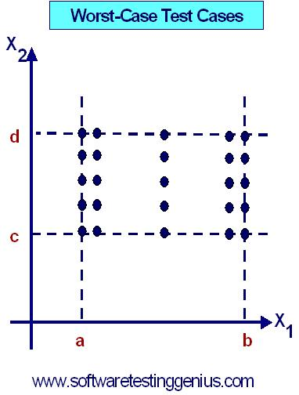

Slide 35
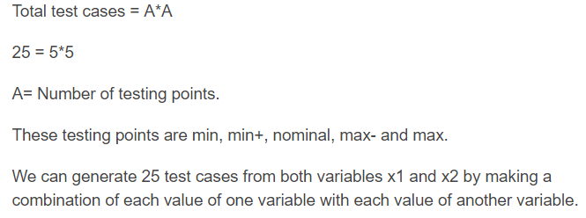
Test cases

Slide 36
Hierarchy
Boundary Value testing of n inputs : 4n + 1
Robustness testing of n inputs : 6n + 1
“Worst case” for boundary value : 5^{n}
“Worst case” for robustness : 7^{n}
1) Boundary Value is a subset of Robustness
2) Worst Case of boundary value is a subset of Worst Case of robustness

Slide 37
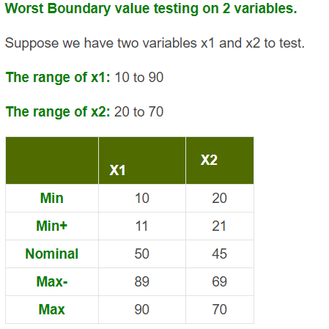
Worst case BVT

Slide 38
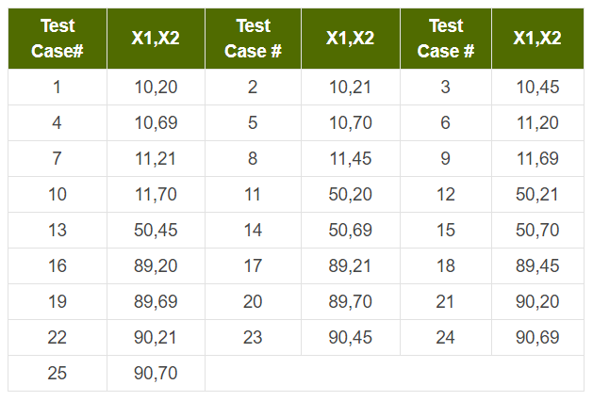

Slide 39
Robust Worst-Case Boundary Value testing
For checking the values that cross both the boundaries i.e. (min-1) and (max+1) paranoid testing, we could go to robust worst-case testing.
This involves the Cartesian product of the seven-element sets i.e. 5 (normal/worst) + 2 (Exceeding boundaries) as variables. These will form the combination for robustness testing.
This consists of 7^{n} test cases.(Where 7 types of boundaries & n is no. of variables). For triangle problem there are 343 test cases. Where there were 125 in worst-case testing.

Slide 40
Special Value Testing
The testing executed by Special Value Testing technique is based on past experiences, which validates that no bugs or defects are left undetected.
Moreover, the testers are extremely knowledgeable about the industry and use this information while performing Special Value testing.
Another benefit of opting Special Value Testing technique is that it is Ad-hoc in nature. There are no guidelines used by the testers other than their “best engineering judgment”.
The most important aspect of this testing is that, it has had some very valuable inputs and success in finding bugs and errors while testing a software.

Slide 41
Special Value Test Cases
Case | Month | Day | Year | Reason
SV-1 | 2 | 28 | 2012 | Feb. 28 in a leap year
SV-2 | 2 | 28 | 2013 | Feb. 28 in a common year
SV-3 | 2 | 29 | 2012 | Leap day in a leap year
SV-4 | 2 | 29 | 2000 | Leap day in 2000
SV-5 | 2 | 28 | 1900 | Feb. 28 in 1900
SV-6 | 12 | 31 | 2011 | End of year
SV-7 | 10 | 31 | 2012 | End of 31-day month
SV-8 | 11 | 30 | 2012 | End of 30-day month
SV-9 | 12 | 31 | 2012 | Last day of defined interval

Slide 42
Random Testing
Random Testing is a form of functional black box testing that is performed when there is not enough time to write and execute the tests.

Slide 43
Random Testing
The basic idea in Random Testing is that, rather than always choose the min, min+, nom, max–, and max values of a bounded variable, use a random number generator to pick test case values.
This avoids any form of bias in testing. It also raises a serious question: how many random test cases are sufficient?
This is usually done through the software application that uses the Random Number Generator function that picks values for a bounded variable a ≤ x ≤ b.
For each type of the output several test cases bundled together, it can be shown in percent % of the total test cases. Just an example: 35% of the total 125 test cases used to check the Isosceles triangle, shown in tabular format.

Slide 44
The table on next slide shows the results of randomly generated test cases. They are derived from a Visual Basic application that picks values for a bounded variable a ≤ x ≤ b.
The formula used here is: x = Int((b – a + 1) * Rnd + a)
Where x is output i.e. one of 4 columns (Nontriangle,scalance, Isosceles, Equilateral.
Function Int returns the integer part of a floating point number, and the function Rnd generates random numbers in the interval [0, 1].
The program keeps generating random test cases until at least one of each output occurs.

Slide 45
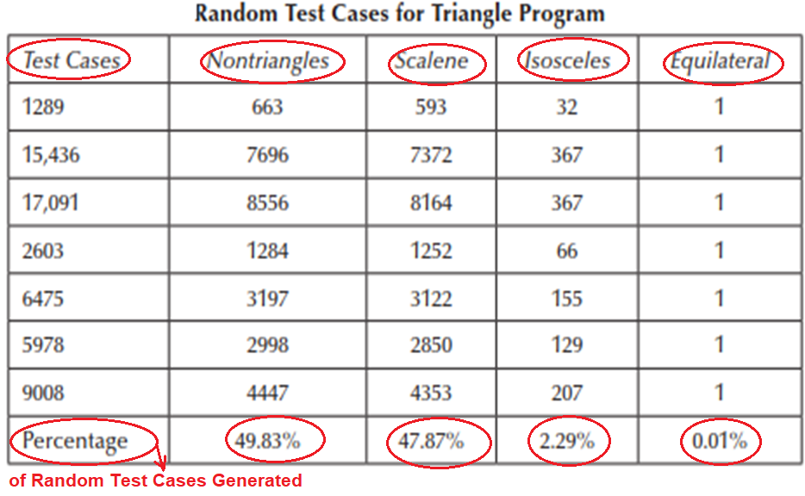

Slide 46
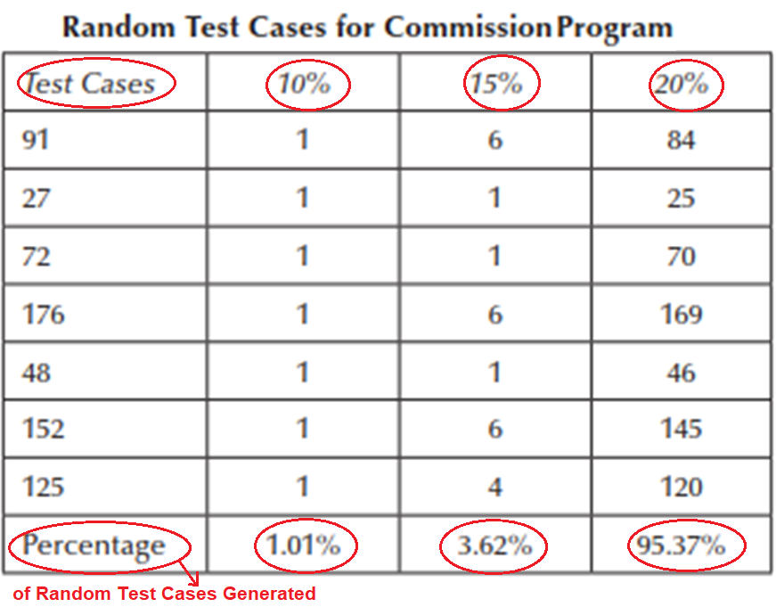

Slide 47
Random Testing Characteristics
Random testing is performed where the defects are NOT identified in regular intervals.
Random input is used to test the system's reliability and performance.
Saves time and effort than actual test efforts.
Other Testing methods Cannot be used to.

